Slide 1
Predicting Energy Usage in California
-UCI Capstone 2023
Frank Dong, Yang Weng, Nima Hendi, Sean Lee

Slide 2
Agenda
01 UC Irvine Relationship
02 Introduction
03 Data
04 Analysis
05 Prediction & Validation — Visualization
07 Report

Slide 3
01 UC Irvine Relationship
Notes:
Meeting 1

Slide 4
Team
UC Irvine:
Accenture:
Frank Dong
Nima Hendi
Yang Weng
Sean Lee
Shawna Tuli
Vishrut Chokshi
Jeff Lu
Ella Liang

Slide 5
02 Introduction
In this project, we want to develop a system to forecast energy usage per sector (residential, commercial, industrial) and per source for California.
Notes:
Meeting 1

Slide 6
Project Summary (California)
Based on historical data from 1960 to 2020, from CA and US.
Prediction for the next 2 year (2020-2022), 5 year (2020-2025),and 10 year (2020-2030).
Prediction for energy uses for Residential, commencial, industrial, Transportation and Total consumption.
Prediction for energy uses for Coal, Natural Gas, Petroleum, Nuclear, Renewable Energy.

Slide 7
Project Process
Scrap and wrangle the data from U.S. Energy Information Administration and California Energy Commission website.
Preprocess the data and store it in SQL database
Build statistical and machine learning models to forecast energy usage per sector and per source
Validate and communicate the results using appropriate visualizations

Slide 8
03 Data
In this project, we will be using data from U.S. Energy Information Administration (https://www.eia.gov/totalenergy/data) and California Energy Commission website (https://www.energy.ca.gov/data-reports). We will be working on datasets that provide monthly energy usage, effects of temperature, and different needs of resources for different sectors. The data sets will be in CSV and EXCEL formats.
Predicting energy uses:
https://docs.google.com/presentation/d/1zvVwxJ04zf214ujSyKs-WahalehKll8IFVgxumDou5M/edit?usp=sharing
SQL database Github Repository
Notes:
Meeting 2

Slide 9
Database
Database store more than ten thousands different features, combined from different category of energy uses, and price.
Data are linked together by MSN index, MSN translation included in data file.
Independent variable: price and consumption table named (All and Price_CA)
Target variable: 5 energy source table and 5 energy sector table.

Slide 10
Data Pipeline
Concatenate target variable and response variable
Transform the data base to be list of features
Convert the value to numerical
Fill in all the NA with 0 (Considering filling with mean value instead)
Data Normalization

Slide 11
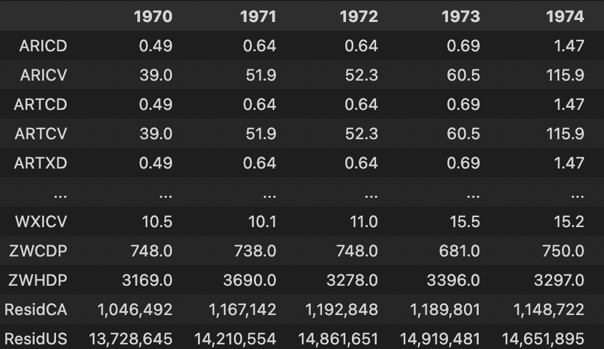
Sample:
Residential Energy Consumption Prediction vs price features (named in MSB index):
Predict next year(or specified year) energy consumption based on other given prices.

Slide 12
Sample (unnormalized):
Residential Energy Consumption Prediction vs price features (named in MSB index):
Predict next year(or specified year) energy consumption based on other given prices.
Years | ARICD | … | ZWCDP | Residential CA
1970 | 0.49 | … | 3169 | 1192848
… | … | … | … | …
2020 | 12.56 | … | 2539 | 1507721

Slide 13
04 Analysis
Notes:
Meeting 3

Slide 14
Data Preprocessing
Split training and test data (45 years training, 5 years validation)
Fill NA with average data.
Eliminate features that are similar. Pick high confident features, by linear regression.
Removed features that were the same except in different units.

Slide 15
Performance Metric Definitions
Mean Squared Error (MSE) is a popular statistical metric used to evaluate the accuracy and precision of models in various fields. It measures the average of the squared differences between predicted and actual values in a dataset.
MAPE (Mean Absolute Percentage Error) is a commonly used metric in forecasting and time series analysis to measure the accuracy of a model's predictions as a percentage of the actual values.

Slide 16
Models
Linear regression: A simple and commonly used method that models the linear relationship between independent and dependent variables.
Logistic regression: A statistical model that predicts binary outcomes and estimates the probability of an event occurring.
SARIMAX (Seasonal AutoRegressive Integrated Moving Average with eXogenous regressors) is a statistical model used for time series analysis that extends the capabilities of the classic ARIMA model by incorporating exogenous variables and accounting for seasonality.

Slide 17
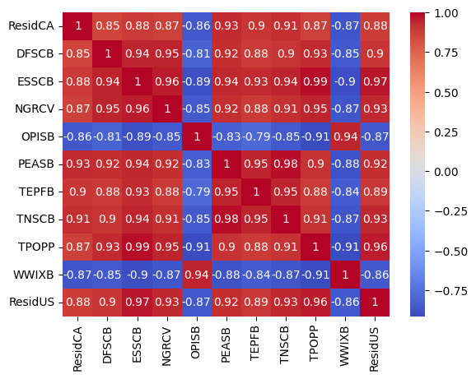
Correlation analysis
Two year Residential Sector Prediction Sample
Select features with high correlation with target (>0.85)
Eliminate duplicate features:
# TNASB & PEASB
# OPSCB & OPISB
Features from 306 down to 11

Slide 18
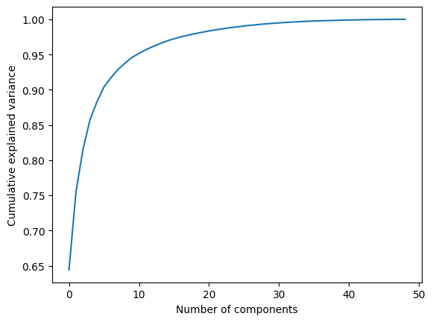
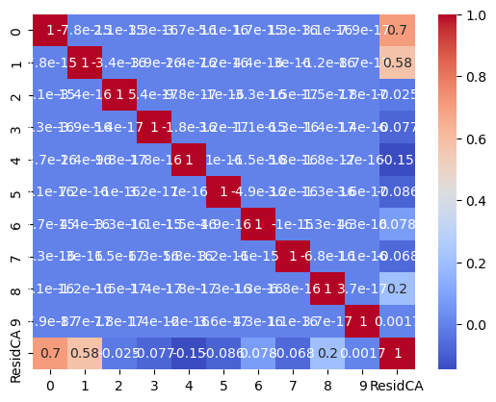
PCA analysis
Select 10 as hyperparameter for pca analysis

Slide 19
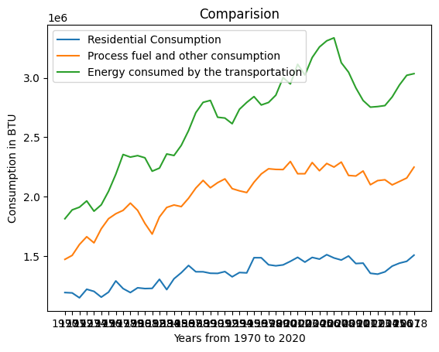
Sample Relation
Residential Consumption in CA
Residential consumption Compare with main features

Slide 20
05 Prediction & Validation
— Visualization
# still working

Slide 21
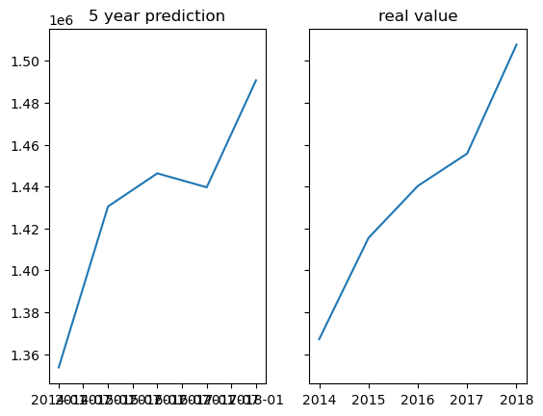
SARIMAX Prediction & Validation
5 year prediction based on pca data
MAPE: 0.009399553213092346

Slide 22
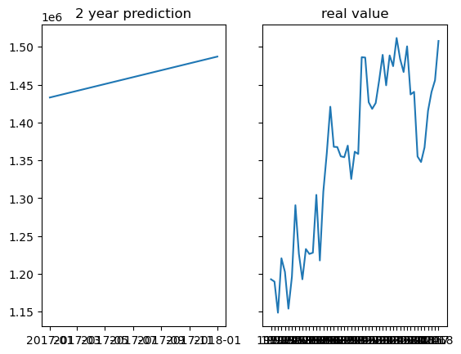
SARIMAX Prediction
2 year prediction based on pca data

